Slide 1




SECURE & RELIABLE HARDWARE
DEPARTMENT OF ELECTRICAL & COMPUTER ENGINEERING
STUDENTS: JADE WILDS, KEANNA WRIGHT, CLAUDIA MORINGS, JOSEPH MILLER INSTRUCTOR: DR. ALI A ABUL-FADL POSTER GROUP 3
TEAM PICTURE:
DESIGN PROBLEM:
A SIGNIFICANT PROBLEM THAT THE CYBERSECURITY INDUSTRY FACES IS THE VULNERABILITY OF INTERNAL MEMORY CHIPS. THIS VULNERABILITY ALLOWS HACKERS TO GAIN CONTROL OF A DEVICE.
PROBLEM STATEMENT:
HACKERS USE A PROCESS CALLED ROWHAMMERING TO USE THE DRAM CHIP FOR THEIR OWN MALICIOUS INTENT.
DESIGN OBJECTIVE:
CREATE ROWHAMMER TESTER ENVIRONMENT FOR EXPERIMENTING WITH ATTACKS AND FINDING BETTER ROWHAMMER MITIGATION TECHNIQUES.
DESIGN CRITERIA/ENGINEERING REQUIREMENTS:
TIME: ADDED TO SUFFICE SEMESTER TIME CONSTRAINT. 0.72
COST: USED TO SUFFICE BUDGETING REQUIREMENT. 0.18
DIFFICULTY: COMPLEXITY OF PROJECT. 0.09

Slide 2
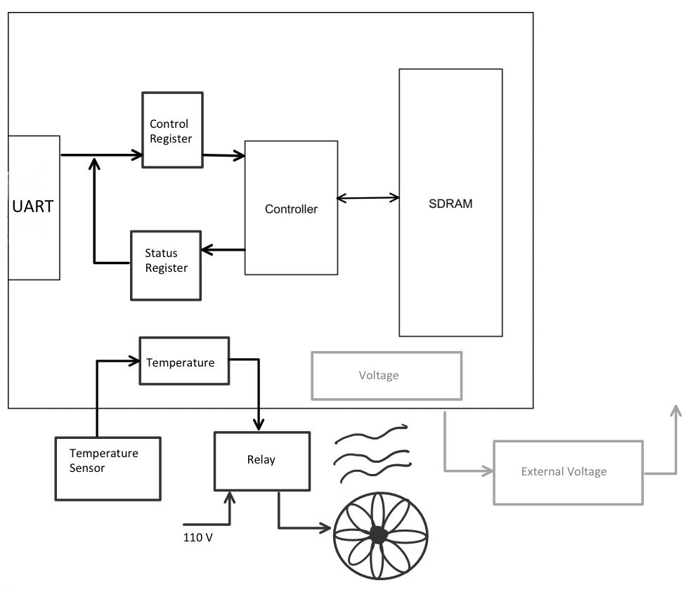
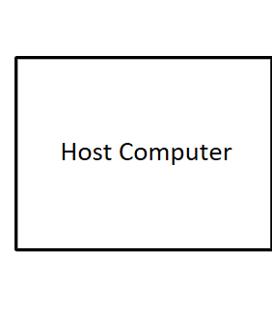
DESIGN ARCHITECTURE
STUDENTS: JADE WILDS, KEANNA WRIGHT, CLAUDIA MORINGS, JOSEPH MILLER INSTRUCTOR: DR. ALI A ABUL-FADL POSTER GROUP 3
OUR DESIGN CONSIST OF THREE MAJOR SECTION: SDRAM CONTROLLER, USER INTERFACE AND HEATER/TEMPERATURE CONTROLLER
OUR HOST COMPUTER COMMUNICATES WITH A UART BASED USER INTERFACE WHICH TALKS TO OUR CONTROL AND STATUS REGISTERS.
THE SDRAM CONTROLLER IS THEN USED TO ACCESS THE DESIRED ADDRESS AND HAMMER IT WITH WRITE AND READ COMMANDS UNTIL SURROUNDING ADDRESS BITS FLIP .
THE HEATER/TEMPERATURE CONTROLLER CONTROLS THE TEMPERATURE IN THE SYSTEM; WHICH HAS AN EFFECT ON BIT FLIPPING.

Slide 3
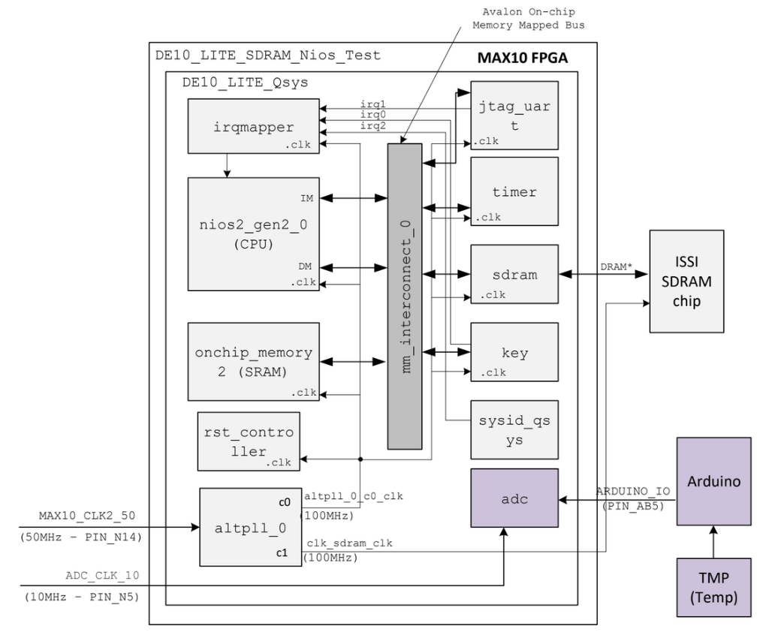
DESIGN IMPLEMENTATION
STUDENTS: JADE WILDS, KEANNA WRIGHT, CLAUDIA MORINGS, JOSEPH MILLER INSTRUCTOR: DR. ALI A ABUL-FADL POSTER GROUP 3
MODELING, BUILDING, TESTING:
USER INTERFACE/ SDRAM CONTROLLER:
THIS DESIGN INCORPORATES A NIOS BASED SOC WITH INTEGRATED PERIPHERALS CONNECTED TOGETHER THROUGH AN AVALON INTERCONNECT.
TESTING WAS COMPLETED BY RUNNING READ AND WRITE SDRAM TESTS.
TEMPERATURE CONTROLLER:
THIS DESIGN IS MADE UP OF THE TMP 36 CONNECTED TO THE ARDUINO THAT PROVIDES THE ADC PORT. FROM THERE IT IS CONNECTED TO THE OVERALL DESIGN.
TESTING WAS DONE BY MONITORING THE DIGITAL CONVERSIONS ON THE ADC AND IMPLEMENTING LOGIC.
ARRIVING AT SOLUTION:
AFTER COLLABORATING WITH INTEL ENGINEERS LAWRENCE LANDIS, GARY WALLICHS, AND KWADWO BOATENG OUR TEAM WAS ABLE TO IMPLEMENT A DESIGN THAT CONFIGURES THE NIOS II EMBEDDED PROCESSOR ARCHITECTURE.
DIAGRAMS/PLANS:
DIAGRAM OF NIOS-BASED SOC DESIGN

Slide 4
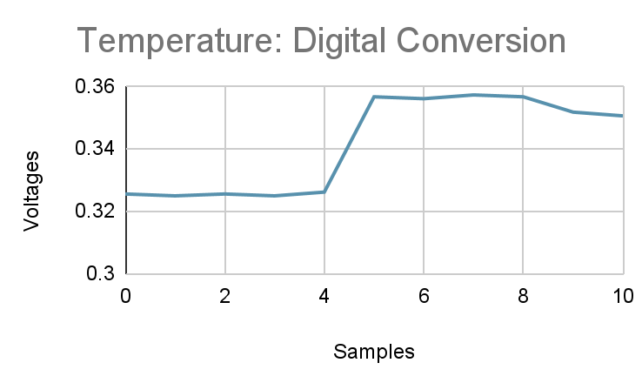
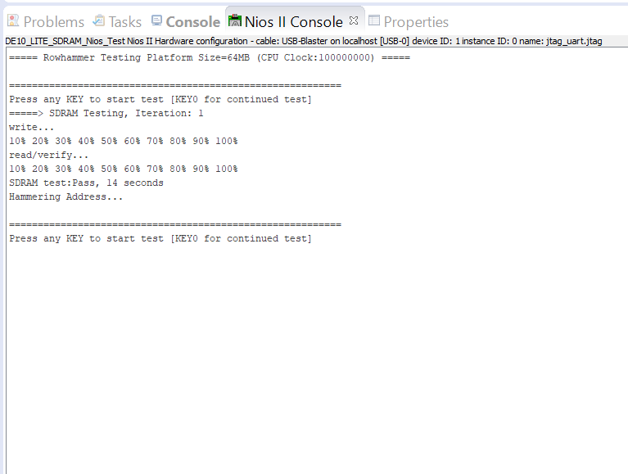
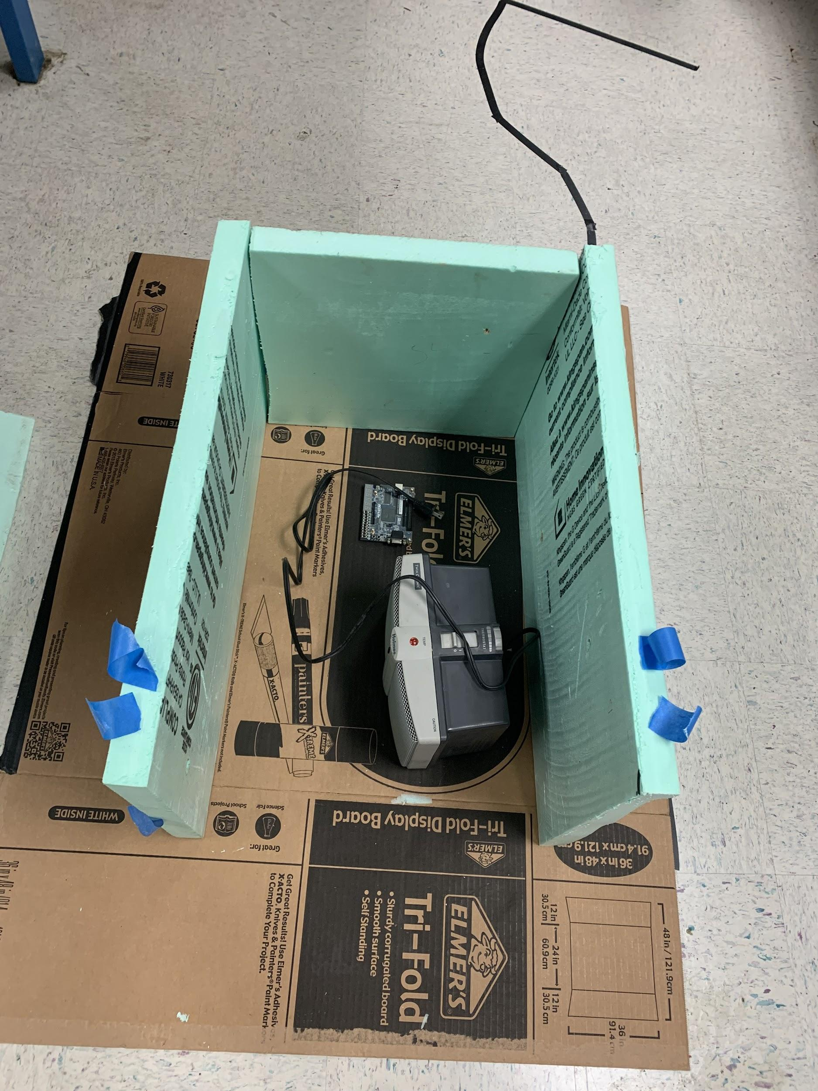
RESULTS:
STUDENTS: JADE WILDS, KEANNA WRIGHT, CLAUDIA MORINGS, JOSEPH MILLER INSTRUCTOR: DR. ALI A ABUL-FADL POSTER GROUP 3
DATA, GRAPHS, IMAGES
DISCUSSION/CONCLUSION:
THESE RESULTS SHOW THAT TESTING ON THE SDRAM CONTROLLER / USER INTERFACE WERE SUCCESSFUL AND THE TEMPERATURE SENSOR IS OUTPUTTING VALUES THAT WILL BE UTILIZED IN OUR DESIGN.
IN THIS PROJECT WE LEARNED ABOUT THE DRAM CHIP, HOW HACKERS USE THE PROCESS OF ROWHAMMERING TO HACK CHIPS, AND THE NEEDED CONDITIONS TO CAUSE A ROWHAMMER ATTACK.
WE HAVE SET THE GROUNDWORK THROUGH OUR RESEARCH AND TESTING IN HOPES THAT THOSE WHO COME AFTER US WILL CONTINUE WHAT WE HAVE STARTED. IN THE FUTURE THIS PROJECT CAN BE FURTHER DEVELOPED BY INCORPORATING USER INTERACTION TO SPECIFY A DESIRED ADDRESS TO HAMMER AND DISPLAYING FLIPPED BITS IN MEMORY.

